Slide 1


Lecture Topic 13: Capital Budgeting
Estimating Cash Flows and Analyzing Risk
Presentation to Cox Business Students
FINA 3320: Financial Management
Presentation to Cox MBA Students
FINA 6214: International Financial Markets

Slide 2
Long-Term Investments
Capital Budgeting Projects

Slide 3
Goals
Learn to evaluate long-term investment projects
  Identify relevant cash flows of projects
  Construct forecasted financial statements
  Calculate free cash flow from assets
  Use NPV investment rule

Slide 4
Relevant Cash Flows
Relevant Cash Flows
  The incremental cash flows associated with the decision to invest in a project
The incremental cash flows for project evaluation consist of any and all changes in the firm’s future cash flows that are a direct consequence of undertaking the project
  Difference between cash flows with the project and cash flows without the project
  Based on free cash flows, not accounting income

Slide 5
Relevant Cash Flows
GM is considering a new car model to replace the Hummer
  GM currently earns $3 billion in Hummer sales
  GM estimates it will sell 50,000 units of the new model and earn $90,000 on each unit (total of 4.5 billion in revenues)
What are the incremental cash flows?
  Cash flows with the new car model minus the cash flows without the new car model

Slide 6
Aspects of Incremental Cash Flows
Sunk Costs
  Costs that have already occurred
  Example: Test market expenses
Opportunity Costs
  Cost of best foregone alternative
  Cash flows lost by taking one course of action over another
Side Effects or Externalities: Erosion
  Erosion (or cannibalization): cash flow transferred to new project from customers and sales of existing products

Slide 7
Aspects of Incremental Cash Flows
Net Working Capital
  Costs associated with an increase in net working capital due to undertaking a project
    Increase in current assets (e.g., inventory and/or A/R) and/or decrease in current liabilities associated with undertaking a capital budgeting project
Financing Costs
  Costs associated with how the project is financed
    Includes interest and dividend expenses
Other Issues
  All cash flows should be after-tax cash flows

Slide 8
Sunk Costs
GM hires The Boston Consulting Group (BCG) to evaluate whether a new car model should be launched to replace the Hummer
The consulting fees are paid no matter what the decision
These fees should not be included in incremental cash flows!
  They are sunk costs

Slide 9
Opportunity Costs
GM paid $300,000 ten years ago for land that could now be used for production facilities
The current market value of the land is $500,000
  Opportunity Cost = $500,000
  Sunk Cost = $300,000
The opportunity cost should be included in incremental cash flows!

Slide 10
Side Effects and Erosion
If GM introduces the new car model a drop in revenues is expected from other car models
Since there is expected to be erosion in sales revenue from these other car models, we must consider the net effect on cash flows
Erosion should be included in incremental cash flows!

Slide 11
Net Working Capital (NWC)
NWC is the difference between CA and CL
  Investment in inventories and A/R net of increase in A/P
Generally, firms invest in NWC at beginning of project (t=0)
  This investment in NWC is recovered at the end of the project
∆NWC should be included in incremental CFs

Slide 12
Net Working Capital (NWC)
GM will increase NWC at the beginning:
  Firm will increase inventories of raw material
  Dealers will require increased A/R financing
At the end of model’s life, NWC will decline:
  Inventories will be allowed to run down
  A/R will be paid down
∆NWC
  Increases at the beginning are cash outflows
  Decreases at the end of the project are cash inflows

Slide 13
Additions to NWC
Given NWC at the beginning of the project (i.e., t=0), we can calculate future NWC as:
  NWC will grow at a rate of X% per year (e.g., 3%)
    i.e., NWC_{Year2} = NWC_{Year1} x (1 + 0.03)
  NWC will equal Y% of sales each period (e.g., 15%)
    i.e., NWC_{Year2} = Sales_{Year2} x (0.15)
Text assumes initial investment in NWC is made in year 0
  So assume this is the case unless told otherwise

Slide 14
Recovery of NWC
NWC is recovered at the end of the project:
  Bring NWC account to zero
    Inventories are run down
    Unpaid bills are paid (both A/R and A/P)
Text assumes initial investment in NWC made in year 0 is all recovered at the end of the project
  So assume this is the case unless told otherwise

Slide 15
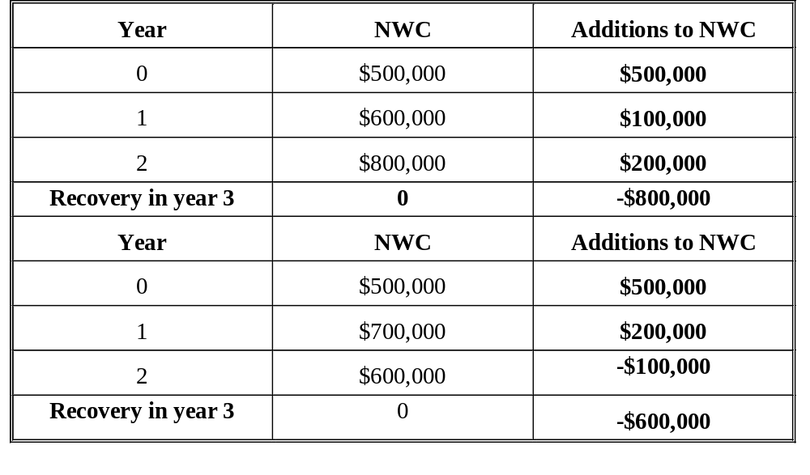
Recovery of NWC

Slide 16
Treatment of Financing Costs
Should you subtract interest expense or dividends when calculating cash flows?
No!
  We discount project cash flows with a cost of capital that is the rate of return required by all investors
  Therefore we should discount the total amount of cash flow available to all investors
They are part of the cost of capital
  If we subtracted them from CFs, we would be double counting capital costs

Slide 17
Depreciation and Capital Budgeting
Depreciation is a non-cash charge
  However, depreciation has cash flow consequences since it affects taxes
Companies often calculate depreciation one way for reporting taxes and another for reporting to investors
  Tax depreciation is typically determined by MACRS
    Salvage value and economic life are ignored
  Many firms use straight line method for stockholders
    Subtract salvage value from cost and divide by asset’s economic useful life (in years)

Slide 18
MACRS
Modified Accelerated Cost Recovery System
  Set forth guidelines that govern tax depreciation
  Created several classes of assets, each with a more-or-less arbitrarily prescribed life called a recovery period or class life
  MACRS class life bears only rough guideline to expected useful economic life
  Major effect has been to shorten the depreciable lives of assets, giving business larger tax deductions and thus increasing their cash flows available for investment
    Cash flows increased since higher early (time value of money) depreciation reduces taxes, and therefore increases cash flow to stakeholders
Companies often calculate depreciation one way for reporting taxes and another for reporting to investors
  Tax depreciation is typically determined by MACRS
    Salvage value and economic life are ignored
  Many firms use straight line method for stockholders
    Subtract salvage value from cost and divide by asset’s economic useful life (in years)

Slide 19
MACRS: Major Classes/Asset Lives
Class Type of Property
3-year Certain specialized short-lived property, race horses over 2 years old
5-year Automobiles, trucks, computers
7-year Most industrial equipment, office furniture, books
10-year Certain longer-lived equipment, vessels, barges, tugs
20-year Farm buildings, sewer pipes, very long-lived equipment
27.5-year* Residential rental property such as apartment buildings
31.5-year* Nonresidential property, including commercial and industrial buildings
*Note: Real estate must be depreciated using the straight line method. Other classes can use either straight line or the accelerated method. Since higher depreciation expense results in lower taxes and higher cash flows, most elect to use the accelerated method.

Slide 20
Half-Year Convention
Under MACRS, assumption is made that the asset is placed in service in the middle of the first year
  For 3-year class property, the recovery period begins in the middle of the first year and ends three years later
  The effect of the half-year convention is that the recovery period extends out one more year than the asset class
    i.e., 3-year assets are depreciated over four fiscal years
  This convention is incorporated in to the MACRS recovery allowance percentages
Half-year convention also applies to straight line

Slide 21
MACRS Depreciation Allowance
Year
3-year
5-year
7-year
1
33.33%
20%
14.29%
2
44.44%
32%
24.49%
3
14.82%
19.2%
17.49%
4
7.41%
11.52%
12.49%
5
11.52%
8.93%
6
5.76%
8.93%
7
8.93%
8
4.45%

Slide 22
Depreciable Basis
The depreciable basis under MACRS is:
  Purchase price of the asset
  Plus: Shipping costs
  Plus: Installation costs
The depreciable basis is not adjusted for salvage value
  i.e., the estimated market value of the asset at the end of the asset’s useful life

Slide 23
Depreciation Summary:
For Tax Purposes
Depreciation is a non-cash charge
  Which has cash flow consequences since it affects taxes
To estimate depreciation expense:
  Calculate depreciable basis
    Cost of asset plus any shipping and/or installation charges
  Ignore economic life and future market value
    i.e., ignore salvage value of asset at end of its useful life
  Use tax accounting rules for deprecation
    MACRS and Straight line methods both use half-year convention

Slide 24
Straight Line versus MACRS
The Cox Company purchased a new computer for $30,000
The computer is treated as a 5-year asset class under MACRS
  Computer expected to have a salvage value of zero in six years
What are the yearly depreciation deductions?
  Using MACRS depreciation method?
  Using straight line depreciation method?

Slide 25
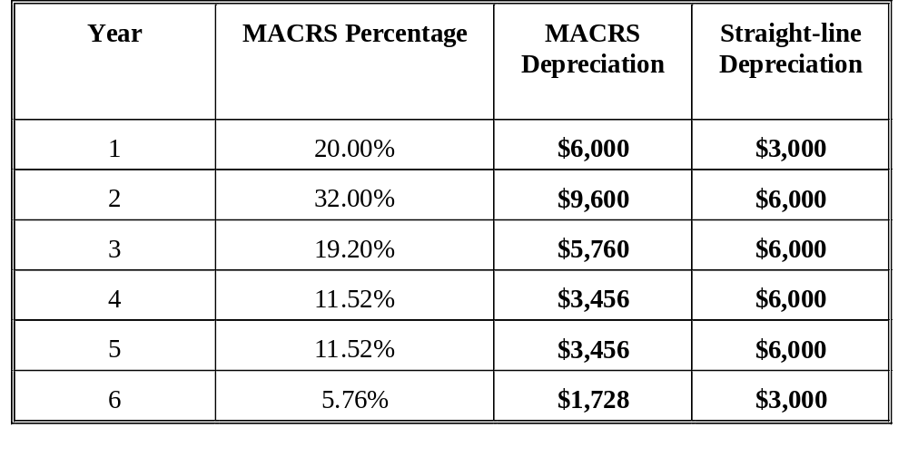
Straight Line versus MACRS

Slide 26
Net Capital Spending
When starting a new project, we often must invest money in fixed assets at the start (t=0)
What happens to those assets at the end of the life of the project?
We ignored salvage value when calculating depreciation expense for tax purposes
  But salvage value must be considered in our cash flows

Slide 27
Salvage Value
If an asset’s value when sold (i.e., salvage value) exceeds (is lower than) its book value, the difference is treated as a gain (loss) for tax purposes
  Taxes = (Market Price – Book Value) x Tax Rate
  After-Tax Salvage Value = Market Price – Taxes
At the end of a project’s life, the book value of a piece of equipment is $0; however, assume you can sell it for $5,000 (and also assume your tax rate is 40%) – What taxes will you pay?
  Taxes = ($5,000 – $0) x 0.40 = $2,000
  After-Tax Salvage Value = $5,000 – $2,000 = $3,000

Slide 28
Salvage Value
Assume the asset’s book value was $1,000 at the end of the project’s life:
  Taxes = ($5,000 – $1,000) x 0.40 = $1,600
  After-Tax Salvage Value = $5,000 – $1,600 = $3,400
Assume the book value was $6,000 at the end of a project’s life:
  Taxes = ($5,000 – $6,000) x 0.40 = -$400
  After-Tax Salvage Value = $5,000 –(-$400) = $5,400

Slide 29
Capital Budgeting Problem
Cox Casting Company
Cox Casting Company (CCC) Project
  Is considering adding a new line to its product mix
  You must complete the capital budgeting analysis
  Production to be set up in unused space in CCC’s plant
  The machinery’s invoice price would be approximately $200,000
    Shipping and installation costs are $10,000 and $30,000 respectively
    Machinery has an economic life of 4 years and CCC has obtained a special ruling which places equipment in MACRS 3-year asset class
    Machinery is expected to have a salvage value of $25,000 after 4 years of use

Slide 30
Capital Budgeting Problem
Cox Casting Company
Proposed Project Summary
  Depreciable Basis
  Economic life of machinery = 4 years
  Salvage value = $25,000
  MACRS 3-year asset class

Slide 31
Capital Budgeting Problem
Cox Casting Company
CCC’s Capital Budgeting Project continued
  New line would generate incremental sales of 1,250 units per year for four years
  Each unit can be sold for $200 in the first year
  Incremental costs would be $100 per unit in the first year, excluding depreciation
  Sales price and costs expected to increase 3% per year
  CCC’s NWC to increase (starting in year 0) by an amount equal to 12% of next year’s sales revenue
  CCC’s tax rate is 40%
  Project’s risk-adjusted cost of capital is 10%

Slide 32
Capital Budgeting Problem
Cox Casting Company
Proposed Project Summary
  Annual unit sales = 1,250
  Unit sales price in year 1 = $200
  Unit costs in year 1 = $100
  Growth rate in sales and costs = 3% per year (inflation)
  NWC = 12% of next year’s sales revenue
  Tax rate = 40%
  Project cost of capital = 10%

Slide 33
Capital Budgeting Problem
Cox Casting Company
Sunk Costs
  Suppose $100,000 had been spent last year on consulting fees to determine the market demand for the new product line
  Should this cost be included in the analysis?
  No!
  This is a sunk cost
  You must focus on incremental investment and operating cash flows

Slide 34
Capital Budgeting Problem
Cox Casting Company
Incremental Costs
  Suppose the plant space could be leased out for $25,000 a year
  Should this cost be included in the analysis?
  Yes!
  This is an opportunity cost since accepting the project means you will not receive the $25,000 in lease income
  After-Tax Opportunity Cost:

Slide 35
Capital Budgeting Problem
Cox Casting Company
Side Effects or Externalities
  Suppose the new product line would decrease sales of CCC’s other products by $50,000 per year
  Should this cost be included in the analysis?
  Yes!
  This is erosion or cannibalization
    Net CF loss on other lines would be a cost to this project
      However, the annual loss would not be the full $50,000 since CCC would save on cash operating costs if its sales dropped
      You would need to figure out the effect on the other products’ operating cash flows

Slide 36
Capital Budgeting Problem
Cox Casting Company
Summary: Side Effects or Externalities
  Externalities can be negative
    If the new product is a substitute to existing products
    Erosion or cannibalization
  Externalities can be positive
    If the new product is a complement to existing products
    Synergy
  In either case, the incremental impact on CFs must be included in your capital budgeting analysis

Slide 37
Capital Budgeting Problem
Cox Casting Company
Annual Depreciation Expense
Year | MACRS % | x | Initial Basis | = Depreciation
1 | 0.3333 |  | $240,000 | $79,992
2 | 0.4444 |  |  | 106,656
3 | 0.1482 |  |  | 35,568
4 | 0.0741 |  |  | 17,784 240,000

Slide 38
Capital Budgeting Problem
Cox Casting Company
Annual Sales and Costs
 | Year 1 | Year 2 | Year 3 | Year 4
Units | 1,250 | 1,250 | 1,250 | 1,250
Unit Price* | $200 | $206 | $212.18 | $218.55
Unit Cost* | $100 | $103 | $106.09 | $109.27
Sales | $250,000 | $257,500 | $265,225 | $273,188
Costs | $125,000 | $128,750 | $132,613 | $136,588
* Price and costs growing at 3% per year after year 1

Slide 39
Capital Budgeting Problem
Cox Casting Company
Adjusting for Inflation
  Is it important to include inflation when estimating CF?
  Nominal rate R > real rate r
  Cost of capital, R, is based on market determined cost of debt and equity and includes a premium for inflation
  If you discount real CFs with the higher nominal rate, R, then your NPV estimate is too low
  Since the cost of capital is already in nominal form, it is usually easiest to adjust cash flows to reflect inflation

Slide 40
Capital Budgeting Problem
Cox Casting Company
Operating Cash Flows
 | Year 1 | Year 2 | Year 3 | Year 4
Sales | $250,000 | $257,500 | $265,225 | $273,188
Costs | $125,000 | $128,750 | $132,613 | $136,588
Deprecation | $79,992 | $106,656 | $35,568 | $17,784
EBIT | $45,008 | $22,094 | $97,044 | $118,816
Taxes (40%) | $18,003 | $8,838 | $38,818 | $47,526
NOPAT | $27,005 | $13,256 | $58,226 | $71,290
+ Depreciation | $79,992 | $106,656 | $35,568 | $17,784
Net Op. CF | $106,997 | $119,912 | $93,794 | $89,074

Slide 41
Capital Budgeting Problem
Cox Casting Company
Change in Net Working Capital (∆NWC)
 | Sales | NWC (12% of next year’s sales) | CF Due to Investment in NWC
Year 0 |  | $30,000 | -$30,000
Year 1 | $250,000 | $30,900 | -$900
Year 2 | $257,500 | $31,827 | -$927
Year 3 | $265,225 | $32,783 | -$956
Year 4 | $273,182 | $0 | $32,783

Slide 42
Capital Budgeting Problem
Cox Casting Company
After-Tax Salvage Value
  When the project is terminated at the end of year 4, the equipment can be sold for $25,000
  But it has been fully depreciated (i.e., its book value is zero)
  Therefore, taxes must be paid on the full salvage value
  For this project, the after-tax salvage cash flow is:

Slide 43
Capital Budgeting Problem
Cox Casting Company
Total Cash Flows from Assets
 | Year 0 | Year 1 | Year 2 | Year 3 | Year 4
Initial Cost | -$240,000 | 0 | 0 | 0 | 0
Op. CF | 0 | $106,997 | $119,912 | $93,794 | $89,074
NWC CF | -$30,000 | -$900 | -$927 | -$956 | $32,783
Salvage CF | 0 | 0 | 0 | 0 | $15,000
Net CF | -$270,000 | $106,097 | $118,985 | $92,838 | $136,857
NPV = $88,012 at R = 10%

Slide 44
Capital Budgeting Problem
Cox Casting Company
NPV Analysis
  Now you have undertaken NPV analysis for Cox Casting Company in terms of its new product line capital budgeting project
    Using the project’s 10% cost of capital NPV is $88,012
    Undertaking this project is expected to increase CCC’s stockholders’ wealth by $88,012
  What do you suggest?
  Obviously, since the NPV is positive, you should accept the project
  However…

Slide 45
Capital Budgeting Problem
Cox Casting Company
Limitations of NPV Analysis
  Fundamental problem in NPV analysis is dealing with uncertain future outcomes
    NPV is only as good as inputs and assumptions used
    Need techniques to identify crucial assumptions and explore what could go wrong
  Techniques
    Sensitivity analysis
    Scenario analysis
    Decision trees

Slide 46
Capital Budgeting Problem
Cox Casting Company
Sensitivity (also called what-if) Analysis
  Sensitivity analysis examines how sensitive NPV is to changes in the underlying assumptions
    Does changing your assumptions (e.g., discount rate, estimated expected cash flows, etc.) change your decision to invest?
  Under sensitivity analysis, one input is changed by a fixed percent while all other inputs are held constant
    Any input variable that causes a large change in NPV is considered a key variable
    Key variables must be controlled by managers in order to obtain expected NPV

Slide 47
Capital Budgeting Problem
Cox Casting Company
Sensitivity Analysis
  Pros
    Indicates whether NPV analysis can be “trusted”
      i.e., if NPV is very sensitive to certain key variables
    Shows where more information is needed
      i.e., which assumptions have the biggest effect on NPV
  Cons
    Treats each variable in isolation, when in reality, variables are often related
    Says nothing about likelihood of a change in the variable

Slide 48
Capital Budgeting Problem
Cox Casting Company
Sensitivity Analysis
% Change | WACC |  | % Change | UNIT SALES |  | % Change | SALVAGE
from |  | NPV | from | Units | NPV | from | Variable | NPV
Base Case | WACC | 88,012 | Base Case | Sold | $88,012 | Base Case | Cost | $88,012
-30% | 7.0% | $113,273 | -30% | 875 | $16,651 | -30% | $17,500 | $84,939
-15% | 8.5% | $100,294 | -15% | 1,063 | $52,331 | -15% | $21,250 | $86,476
0% | 10.0% | $88,012 | 0% | 1,250 | $88,012 | 0% | $25,000 | $88,012
15% | 11.5% | $76,380 | 15% | 1,438 | $123,694 | 15% | $28,750 | $89,549
30% | 13.0% | $65,352 | 30% | 1,625 | $159,375 | 30% | $32,500 | $91,086

Slide 49
Capital Budgeting Problem
Cox Casting Company
Sensitivity Analysis
Change from |  | Resulting NPV (000s)
Base level | WACC (r) | Unit sales | Salvage
-30% | $113 | $17 | $85
-15% | $100 | $52 | $86
0% | $88 | $88 | $88
15% | $76 | $124 | $90
30% | $65 | $159 | $91

Slide 50
Capital Budgeting Problem
Cox Casting Company
Sensitivity Analysis
Unit Sales
NPV
(000s)
88
Salvage
R
-30 -20 -10 Base 10 20 30 (%)

Slide 51
Capital Budgeting Problem
Cox Casting Company
Scenario Analysis
  Scenario analysis is a variant of sensitivity analysis that examines different likely scenarios, each involving multiple variables
  For example, the following three scenarios could apply to CCC:
    Best Case: If product acceptance is strong, unit sales = 1,600 and price = $240 per unit (25% probability)
    Most Likely (Base) Case: Unit sales = 1,250 and price = $200 per unit (50% probability)
    Worst Case: If product acceptance is poor, unit sales = 900 and price = $160 (25% probability)

Slide 52
Capital Budgeting Problem
Cox Casting Company
Scenario Analysis
  For each of the three scenarios, you need to calculate the NPV
  This type of analysis allows for interrelationships between variables
  Generally assumes that good or bad outcomes always occur together

Slide 53
Capital Budgeting Problem
Cox Casting Company
Best scenario: 1,600 units @ $240
Worst scenario: 900 units @ $160
Scenario | Probability | NPV(000s)
Best | 0.25 | $279
Base | 0.50 | 88
Worst | 0.25 | -49
E(NPV) = $101.5
σ(NPV) = 116.6
CV(NPV) = σ(NPV)/E(NPV) = 1.15

Slide 54
Capital Budgeting Problem
Cox Casting Company
Scenario Analysis
  Are there any problems with scenario analysis?
  Yes!
  Scenario analysis only considers a few possible outcomes
  Scenario analysis assume that inputs are perfectly correlated
    All ‘bad’ values occur together and all ‘good’ values occur together

Slide 55
Capital Budgeting Problem
Cox Casting Company
Decision Tree Analysis
  A technique for identifying sequential decisions in NPV analysis
    Allows you to graphically represent the alternatives available to you in each period and the likely consequences of your actions
Monte Carlo Simulation
  An approach that analyzes projects the way you might analyze gambling strategies
    Allows for thousands of alternatives using random draws from distributions defined for each key variable

Slide 56
Evaluating Equipment with Different Economic Lives
Replacement Chain
Equivalent Annual Cost

Slide 57
Two Methods
Replacement Chain Method
  Also called Matching Cycles Method
    This method replicates multiple cycles of asset lives until the two pieces of equipment have the same number of years
Equivalent Annual Cost Method (EAC)
  Also called the annuity method
    The present value of a project’s costs calculated on an annual basis
Assumptions
    Initial costs versus maintenance
    Perpetuity

Slide 58
Example: Two Methods
Assumptions
  Project requires purchase of machinery
  Two machine alternatives
  Machine A has a 3 year life
  Machine B has a 2 year life
  Project risk-adjusted cost of capital is 8%

Slide 59
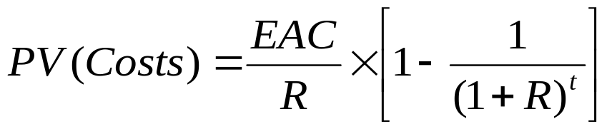
Example: Two Methods
Approach 1:Replacement Chain Method
Approach 2: EAC
Approach 1: Matching Cycles
Two cycles of project A ⇒ 6 years
Three cycles of project B ⇒ 6 years

Slide 60
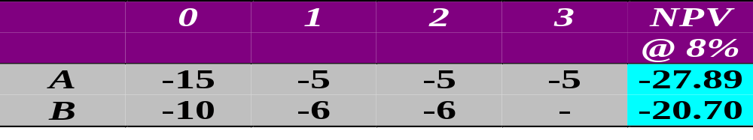
Example: Replacement Chain
NPV_{A}=-27.89
NPV_{A}=-27.89
0
2
3
4
6
NPV_{B}=-20.70
NPV_{B}=-20.70
NPV_{B}=-20.70
For A: NPV = -27.89 - 27.89/(1.08)³ = -$50.03
For B: NPV = -20.70 - 20.70/(1.08)² - 20.70/(1.08)⁴ = -$53.66
Choose A

Slide 61
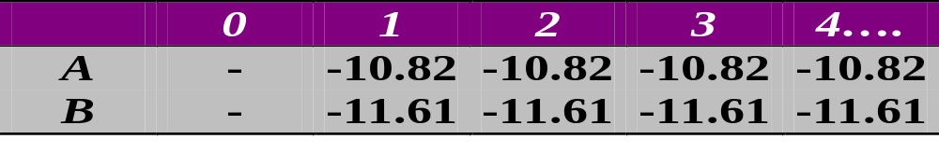
Example: Equivalent Annual Cost
Approach 2: Equivalent Annual Cost
EAC = NPV_{ONE CYCLE}/[1/r(1 – (1 + r)^{-T})] = NPV_{ONE CYCLE} /A^{T}_{r}
  For A: EAC = -27.89/A³_{8%} = -27.89/2.577 = -$10.82
  For B: EAC = - 20.70/A²_{8%} =-20.70/1.783 = -$11.61
Choose A

Slide 62
Evaluating Cost Cutting Proposals

Slide 63
Evaluating Cost Cutting Proposals
Consider a project to automate some part of an existing process
    Necessary equipment costs $80,000 to buy and install
    Project will save $22,000 per year (pre-tax) by reducing labor and material costs
    Equipment is 5-year MACRS and is expected to have a salvage value of $20,000 after 5 years
    The tax rate is 34%
    The risk-adjusted discount rate is 10%
  Note: There is no working capital consequences
Should you undertake the project?

Slide 64
Evaluating Cost Cutting Proposals
Step 1: Depreciation:
Depreciation of $80,000 of 5-year equipment using MACRS
 | MACRS% | Depreciation | Book value
1 | 20.00 | 16,000 | 64,000
2 | 32.00 | 25,600
3 | 19.20 | 15,360
4 | 11.52 | 9,216
5 | 11.52 | 9,216 | 4,608
6 | 5.76 | 4,608 | 0
 | 100.00 | 80,000

Slide 65
Evaluating Cost Cutting Proposals
 | Year 1 | Year 2 | Year 3 | Year 4 | Year 5
Rev – Exp | 22,000 | 22,000 | 22,000 | 22,000 | 22,000
Deprec. | 16,000 | 25,600 | 15,360 | 9,216 | 9,216
EBIT | 6,000 | -3,600 | 6,640 | 12,784 | 12,784
Taxes @34% | 2,040 | -1,224 | 2,258 | 4,347 | 4,347
NI

Slide 66
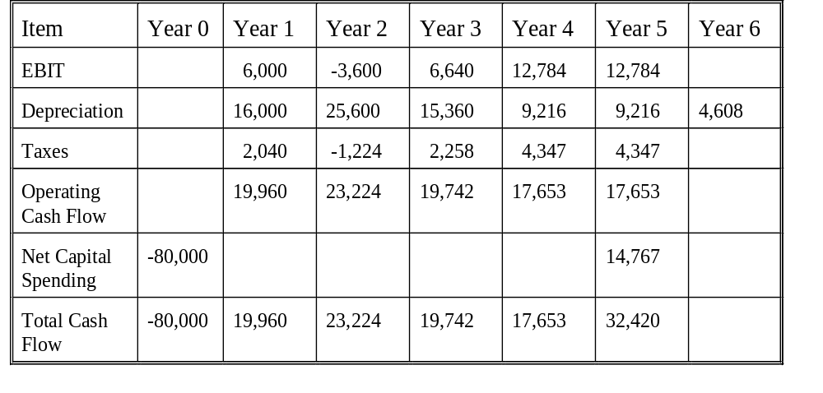
Evaluating Cost Cutting Proposals
NPV = $4,359

Slide 67
Evaluating Cost Cutting Proposals
Should you undertake the project?
Yes!
The cost cutting project is expected to produce a positive NPV

Slide 68
Thank You!
Charles B. (Chip) Ruscher, PhD
Department of Finance and Business Economics

